Slide 1


2019
Department
Of Computer
Science
&
Electrical And
Electronics
Engineering
MATH-IV
KAS -402
2020-2021
Dr.Rupa Sharma
Associate Professor
vsrsrsys@gmail.com
Notes:
Thisv is Cover page

Slide 2
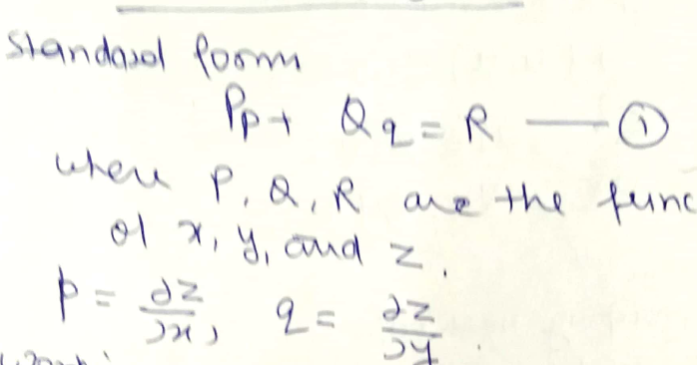
Linear partial differential equation of the first order- Lagrange’s equation

Slide 3
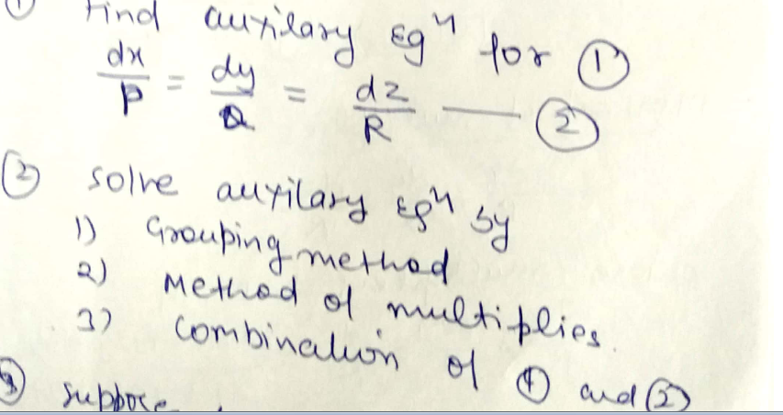
Working Rule

Slide 4
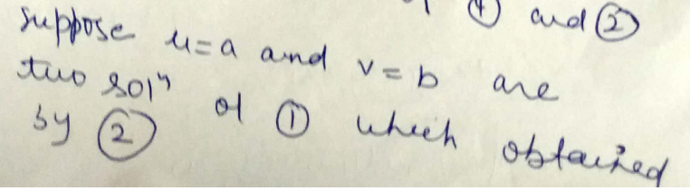
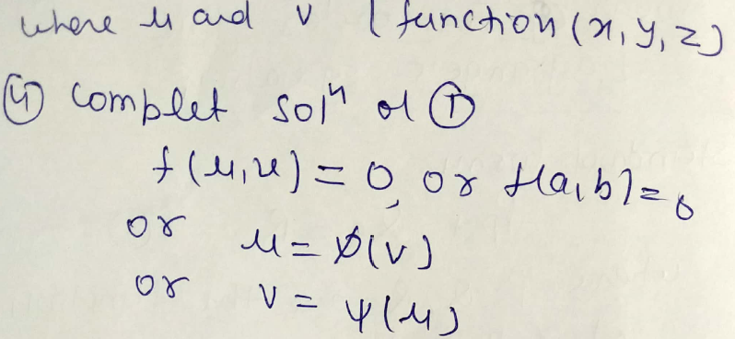

Slide 5
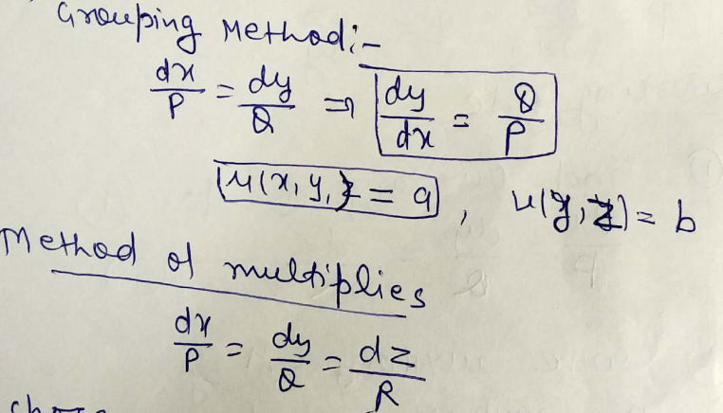
NOTE

Slide 6
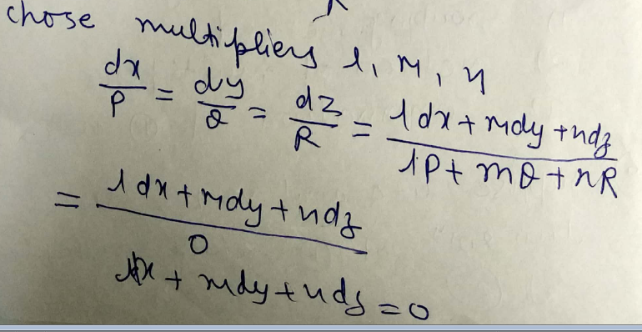
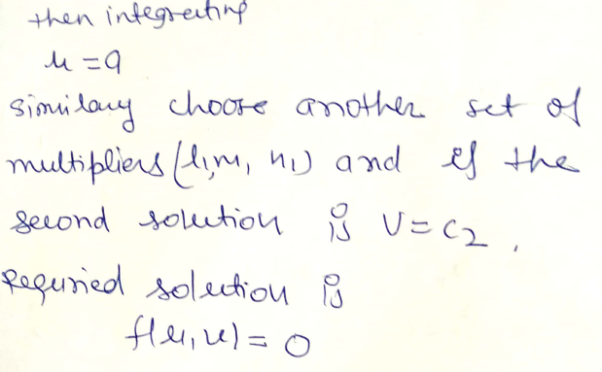

Slide 7
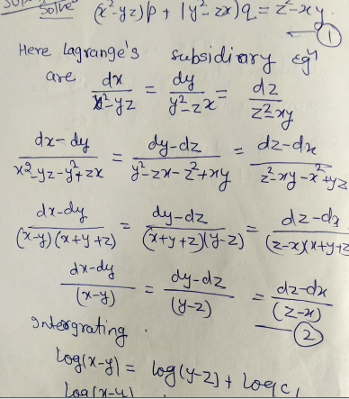

Slide 8
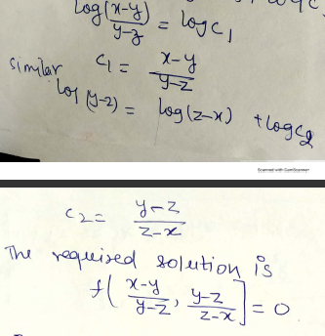

Slide 9
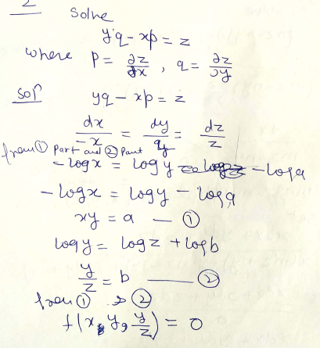

Slide 10
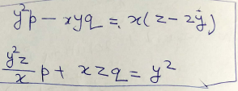
HOME WORK

Slide 11
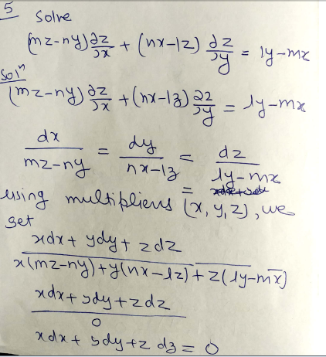
BY Multiplication method

Slide 12
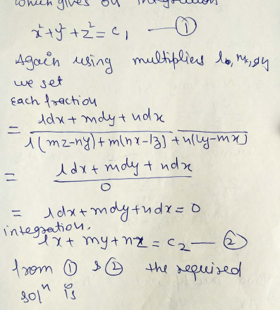


Slide 13
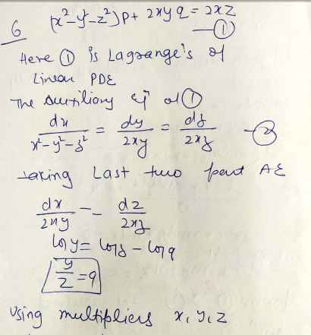

Slide 14
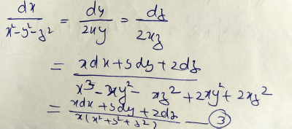
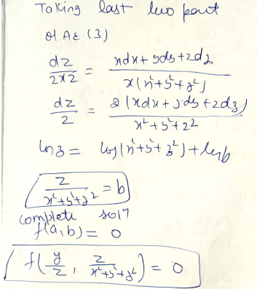

Slide 15


HOME WORK

